Slide 1
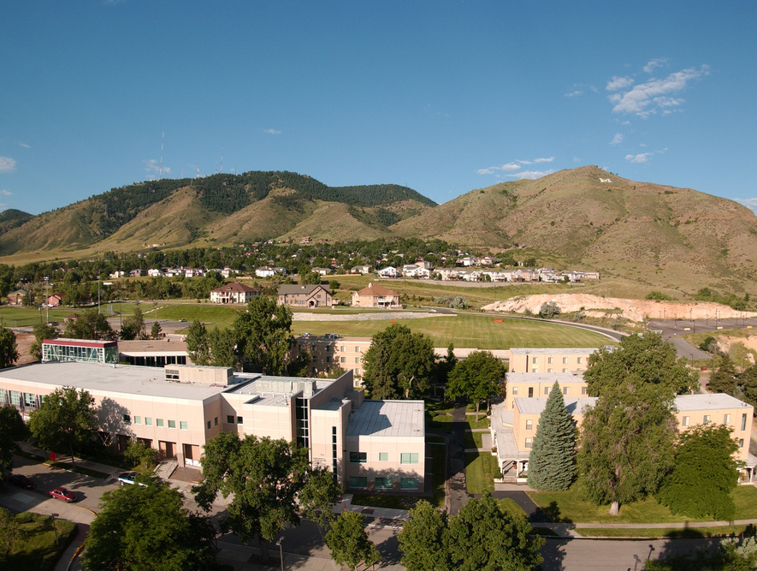
Colorado School of Mines
Computer Vision
Professor Tom Williams
Dept of Computer Science
http://inside.mines.edu/~twilliams/
‹#›

Slide 2
2D-2D Coordinate Transforms

Slide 3
2D Rigid Frame Transformations
The pose of one 2D frame with respect to another is described by
Translation vector t=(Δx,Δy)^{T}
Rotation angle θ
Rotation can also be represented as a 2x2 matrix R
Object shape and size is preserved
y’
y
x’
t
θ
x
‹#›

Slide 4
Rotations in 2D
Let’s derive the formula for a 2D rotation
y
y’
x’
θ
x
‹#›

Slide 5
Rotations in 2D
y
y’
P
x’
θ
O
A
x
‹#›

Slide 6
Rotations in 2D
y
y’
P
x’
θ
O
A
x
‹#›

Slide 7
Rotations in 2D
y
y’
P
x’
Φ
B
θ
O
A
x
‹#›

Slide 8
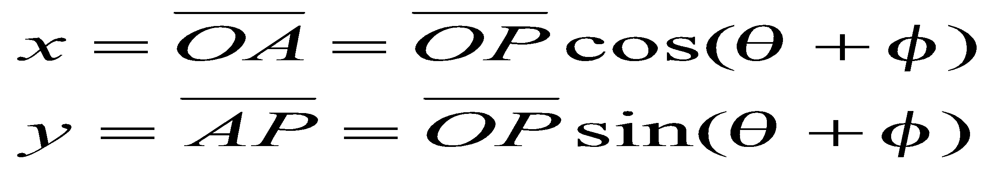
Rotations in 2D
y
y’
P
x’
Φ
B
θ
O
A
x
‹#›

Slide 9
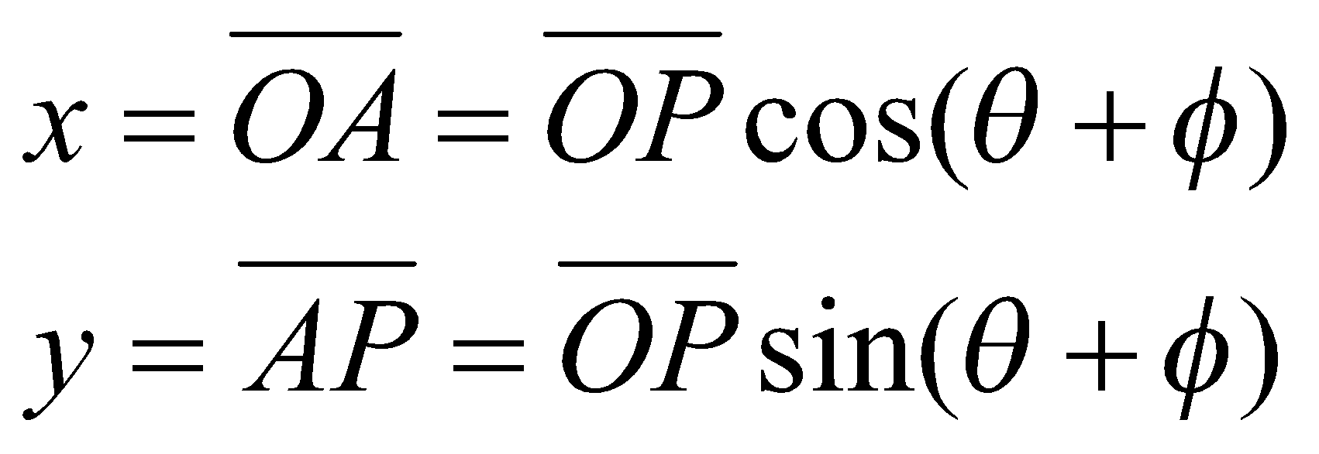
Rotations in 2D
y
y’
P
x’
Φ
B
θ
O
A
x
‹#›

Slide 10
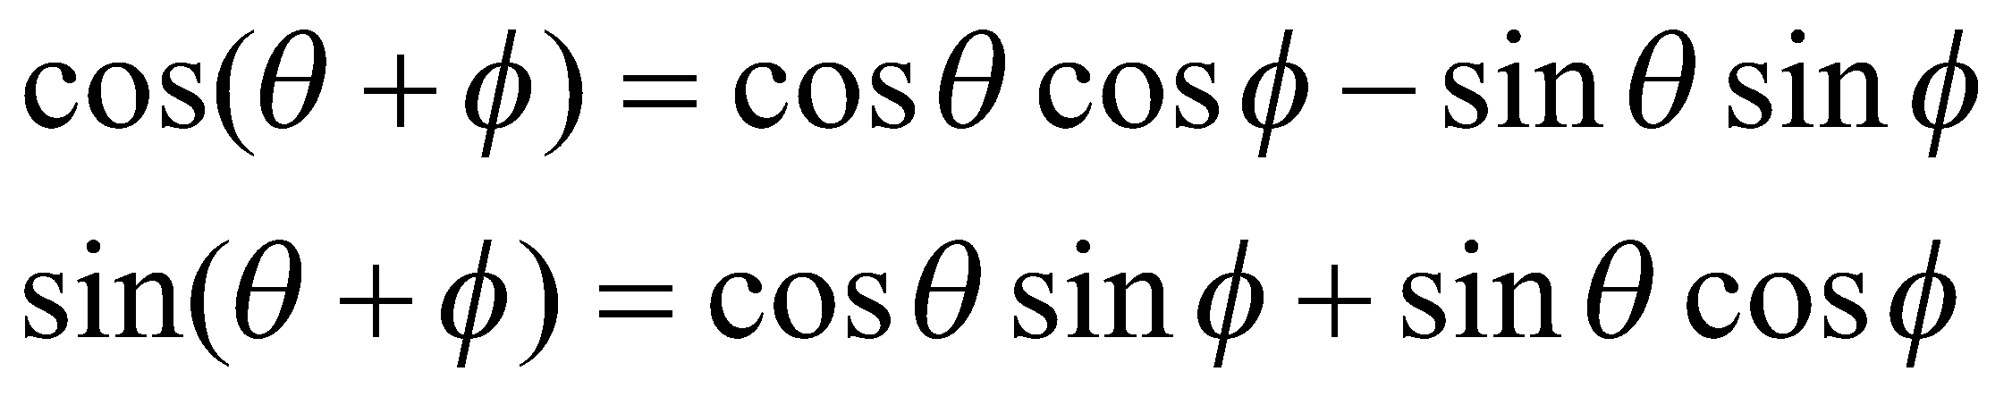
Rotations in 2D
y
y’
P
x’
Φ
B
θ
O
A
x
‹#›

Slide 11
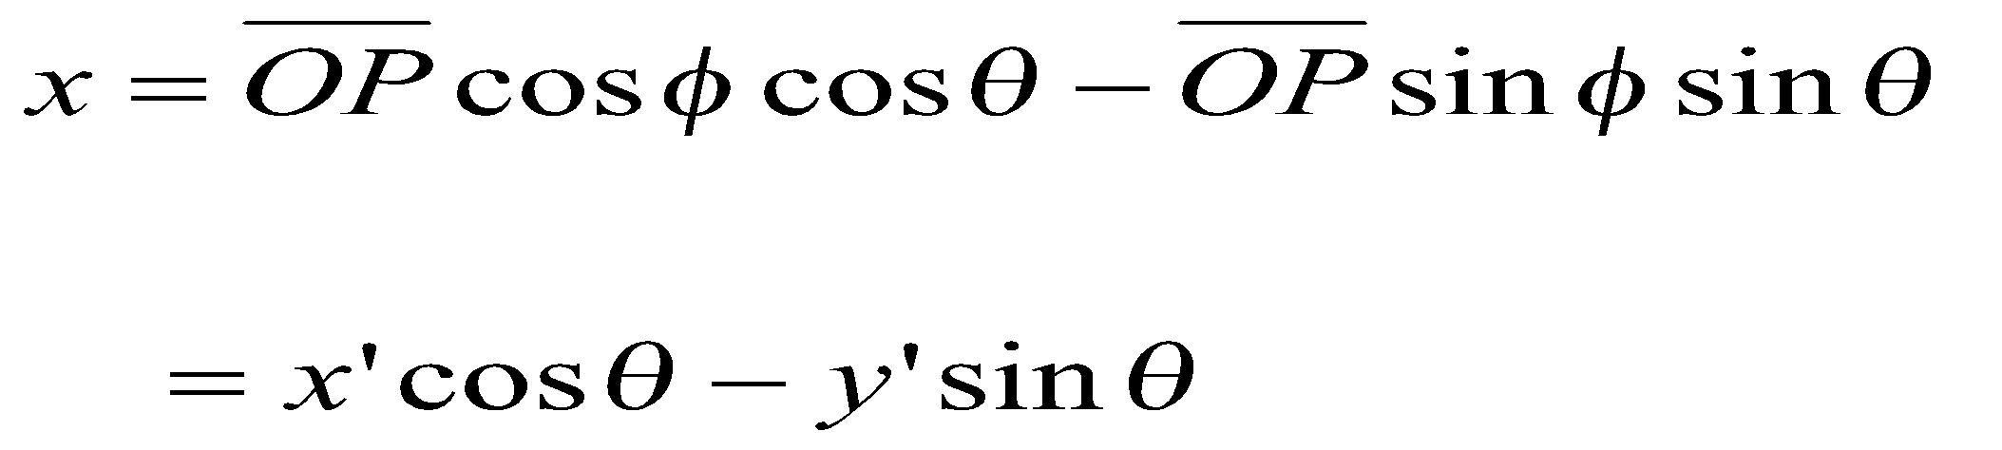
Rotations in 2D
y
y’
P
x’
Φ
B
θ
O
A
x
‹#›

Slide 12
Rotations in 2D
y
y’
P
x’
x’
y’
Φ
B
θ
O
A
x
‹#›

Slide 13
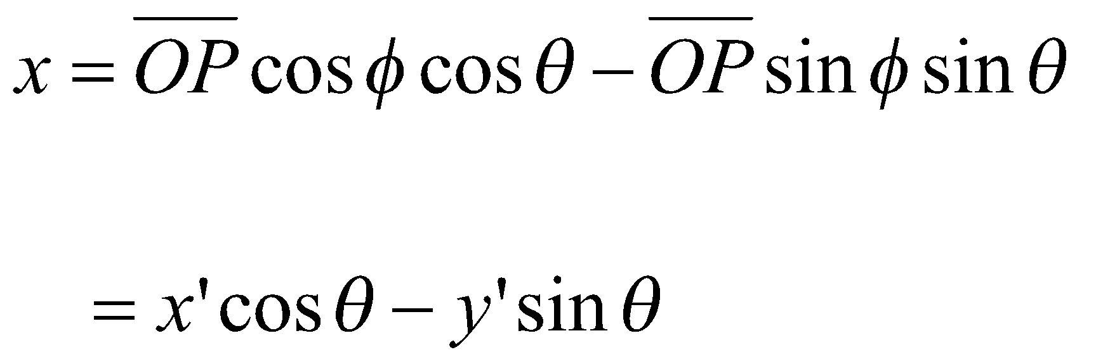
Rotations in 2D
y
y’
P
x’
x’
y’
Φ
B
θ
O
A
x
‹#›

Slide 14

Rotations in 2D
y
y’
P
x’
x’
y’
Φ
B
θ
O
A
x
‹#›

Slide 15
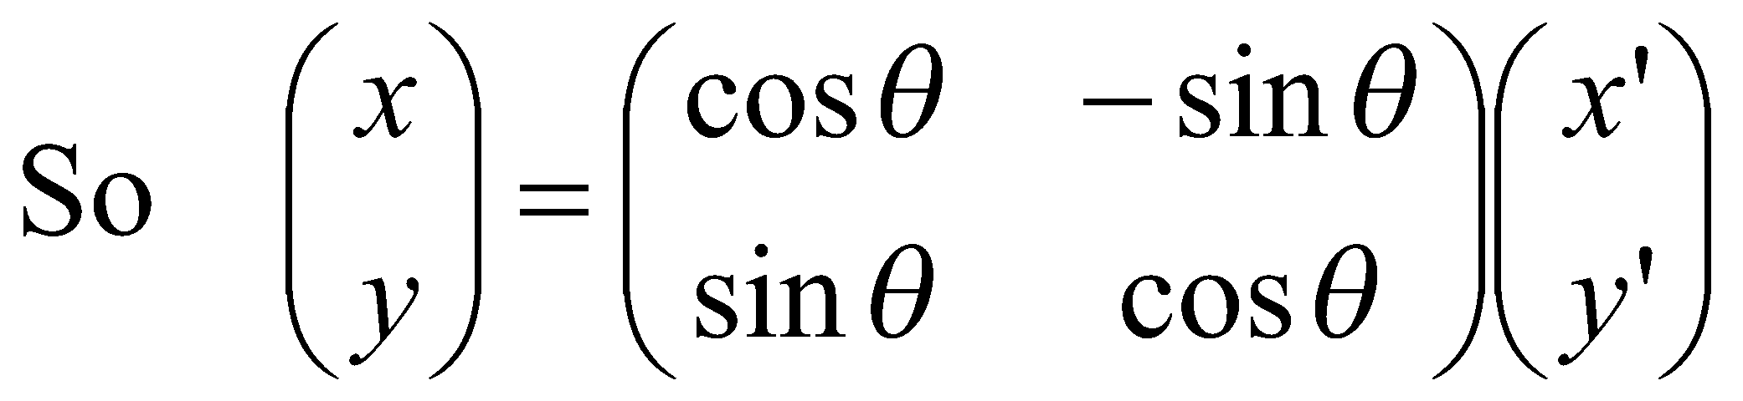
Rotations in 2D
y
y’
P
x’
x’
y’
Φ
B
θ
O
A
x
‹#›

Slide 16
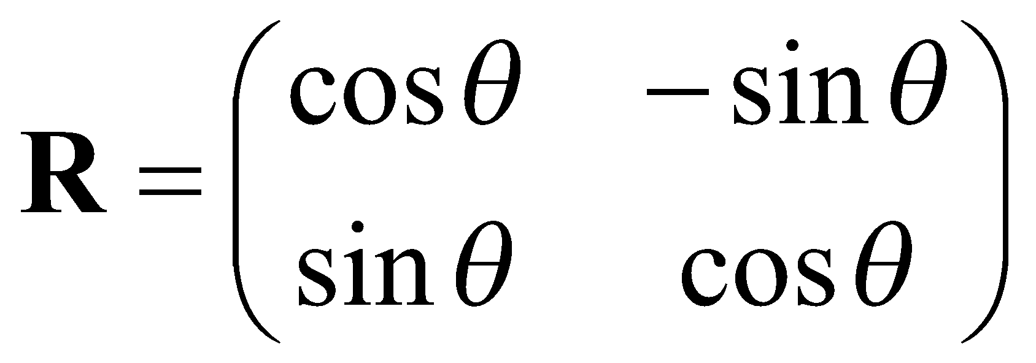
Rotations in 2D
y
y’
P
x’
x’
y’
Φ
B
θ
O
A
x
R
‹#›

Slide 17

Rotations in 2D
R describes the orientation of the primed frame with respect to the unprimed frame.
y
y’
R is orthonormal
Rows, columns are orthogonal (r₁∙r₂ = 0, c₁∙c₂ = 0)
(in both directions you get cosθsinθ-cosθsinθ)
Transpose is the inverse; RR^{T} = I
Determinant is |R| = 1
x’
θ
x
‹#›

Slide 18

Rotations in 2D
R describes the orientation of the primed frame with respect to the unprimed frame.
y
y’
R is orthonormal
Rows, columns are orthogonal (r₁∙r₂ = 0, c₁∙c₂ = 0)
(in both directions you get cosθsinθ-cosθsinθ)
Transpose is the inverse; RR^{T} = I
Determinant is |R| = 1
x’
θ
x
WE CARE BECAUSE THIS MEANS THAT
‹#›

Slide 19
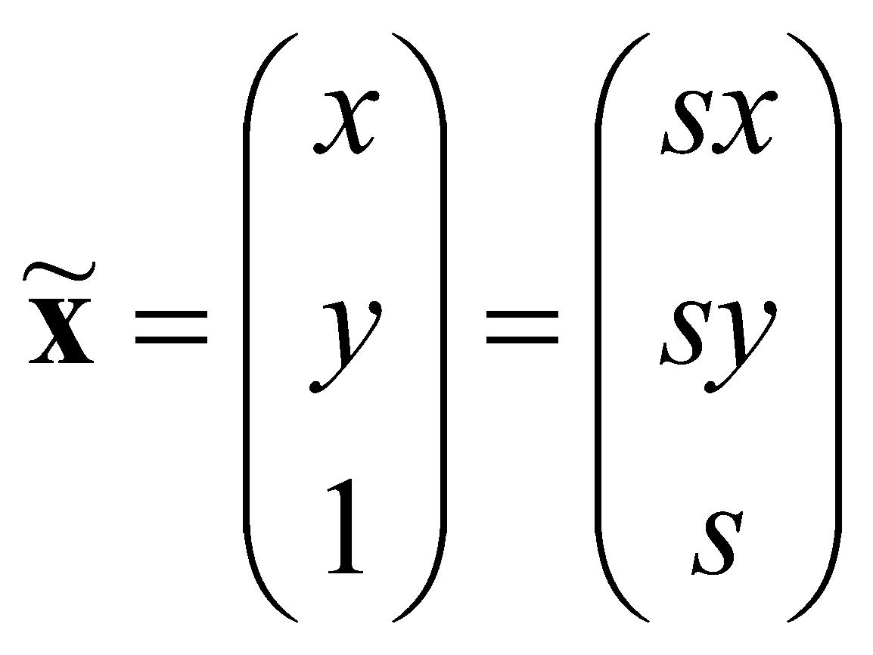
Homogeneous Coordinates
Points can be represented using homogeneous coordinates
This simply means to append a 1 as an extra element
If the 3rd element becomes ≠ 1, we divide through by it

Slide 20
Homogeneous Coordinates
Points can be represented using homogeneous coordinates
This simply means to append a 1 as an extra element
If the 3rd element becomes ≠ 1, we divide through by it
Effectively, vectors that differ only by scale are considered to be equivalent

Slide 21
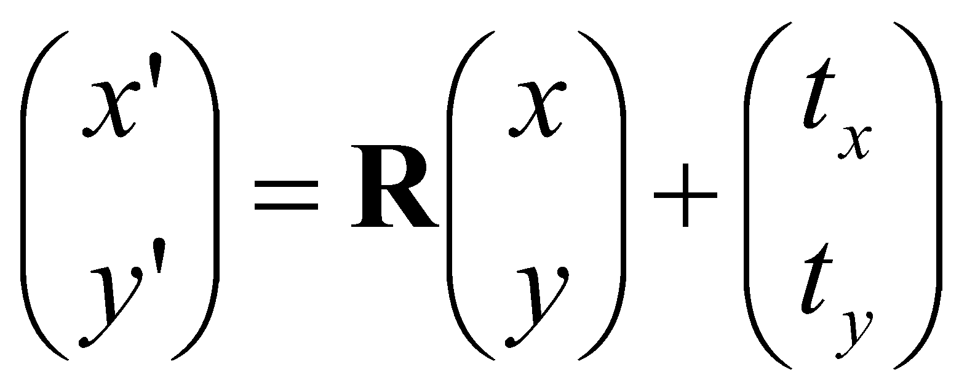

Homogeneous Coordinates
Points can be represented using homogeneous coordinates
This simply means to append a 1 as an extra element
If the 3rd element becomes ≠ 1, we divide through by it
Effectively, vectors that differ only by scale are considered to be equivalent
This simplifies transform equations; instead of
‹#›

Slide 22
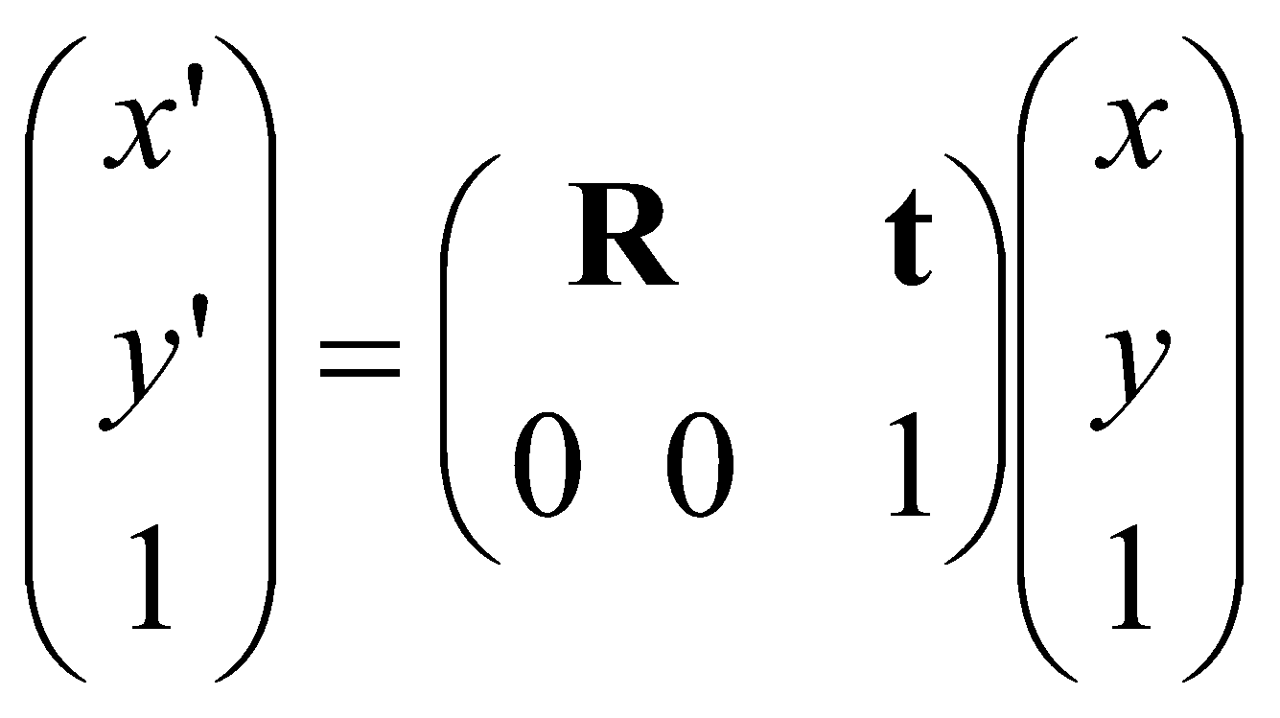

Homogeneous Coordinates
Points can be represented using homogeneous coordinates
This simply means to append a 1 as an extra element
If the 3rd element becomes ≠ 1, we divide through by it
Effectively, vectors that differ only by scale are considered to be equivalent
This simplifies transform equations; instead of
we have
‹#›

Slide 23
Example
Transform the 2D point x = (10, 20)^{T} using a rotation of 45 degrees and translation of (+40, -30).
Point in Homogeneous Coordinates?
Rotation Matrix R?
Translation Matrix T?
Full Transformation Matrix?
How do we apply this transformation to the point?

Slide 24
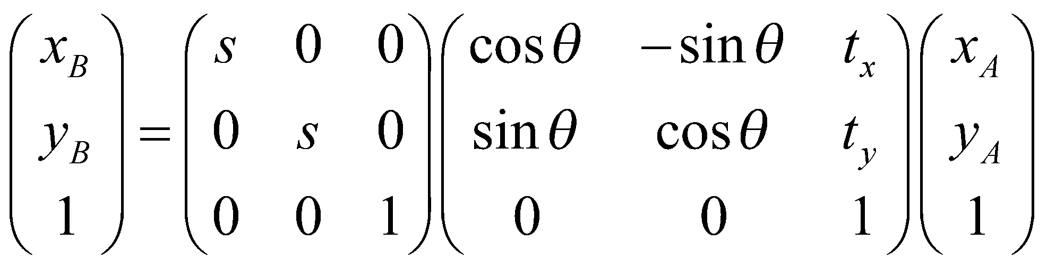

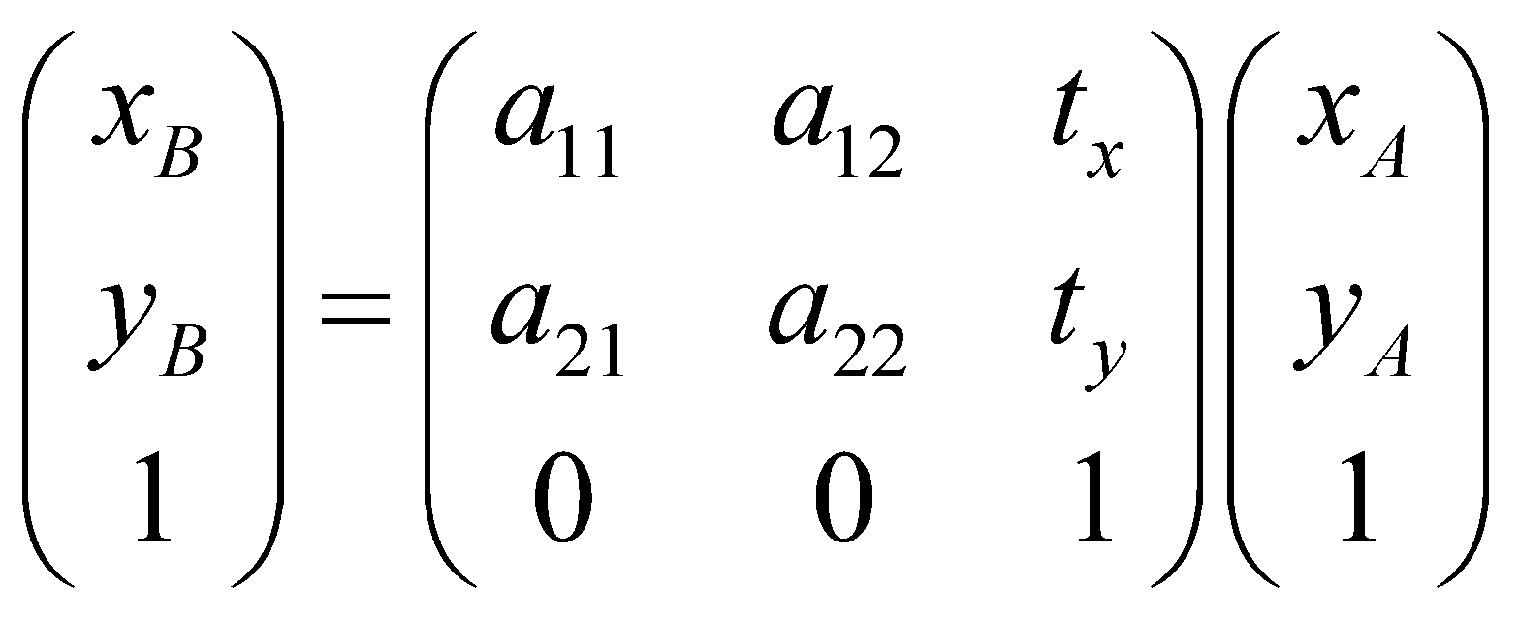

Other 2D-2D Transforms
Scaled (similarity) transform
preserves angles but not distances
Affine transform
Models rotation, translation, scaling, shearing, and reflection
How many degrees of freedom? How many pairs of corresponding points needed to calculate transformation?
‹#›
Notes:
Six degrees of freedom (six numbers)
Three points: each point contributes two equations (for x and for y).

Slide 25
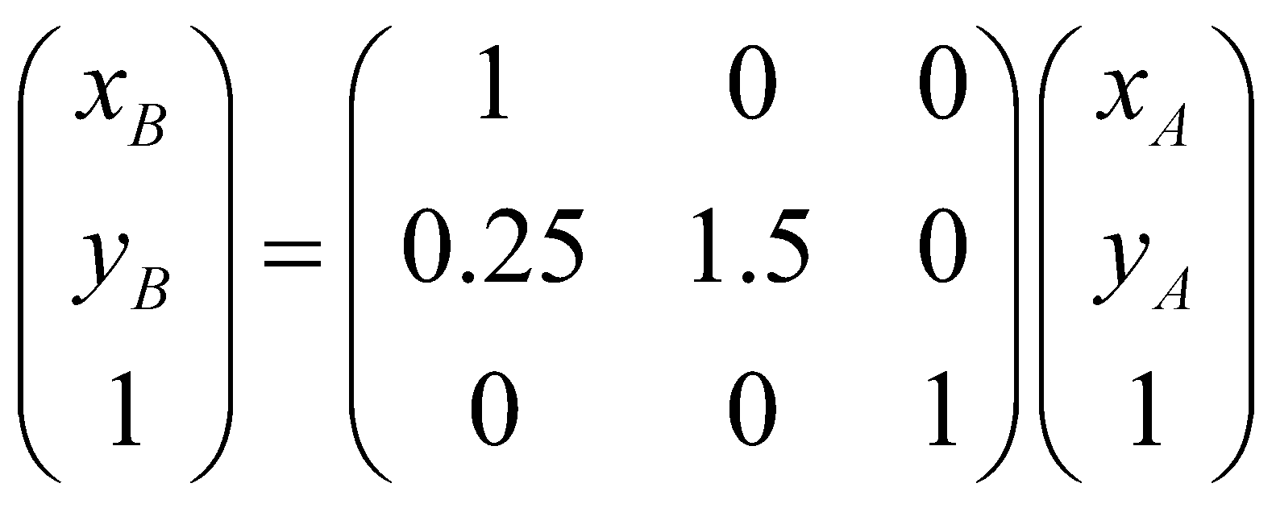
Example
Image “A” is modified by the affine transform below. Sketch image “B”
0,0
50,0
0,50
50,50
A
‹#›
Notes:
0,0 => 0,0
50,0 => 50,12.5
0,50 => 0,75
50,50 => 50, 87.5
Affine transforms: parallel lines remain parallel, but things may be rotated or skewed.

Slide 26
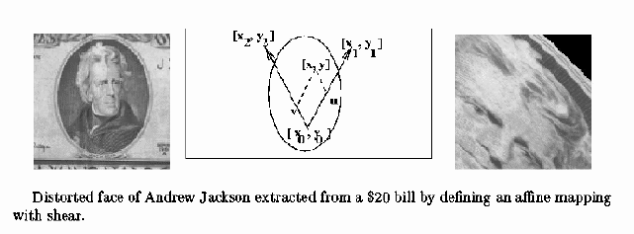
Example Affine Warp
from http://www.cse.msu.edu/~stockman/CV
‹#›
Notes:
(Kind of hard to see the transform but that’s okay. The point is an affine transform can rotate and skew it. Of course you can argue that Jackson was already a pretty skewy person.)

Slide 27
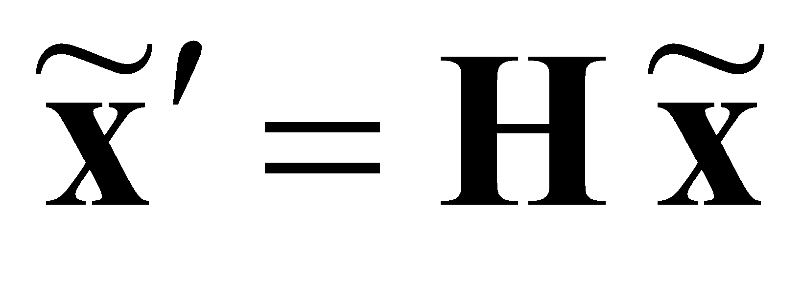
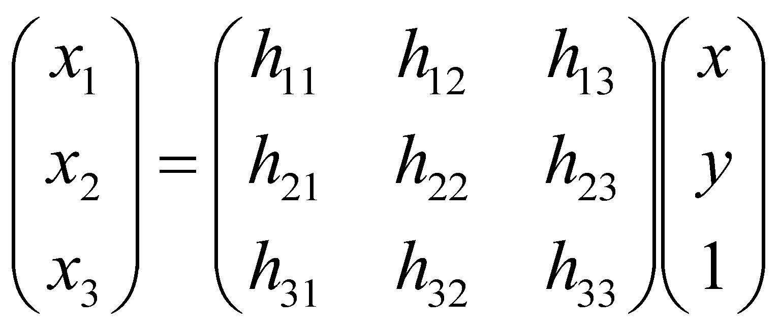

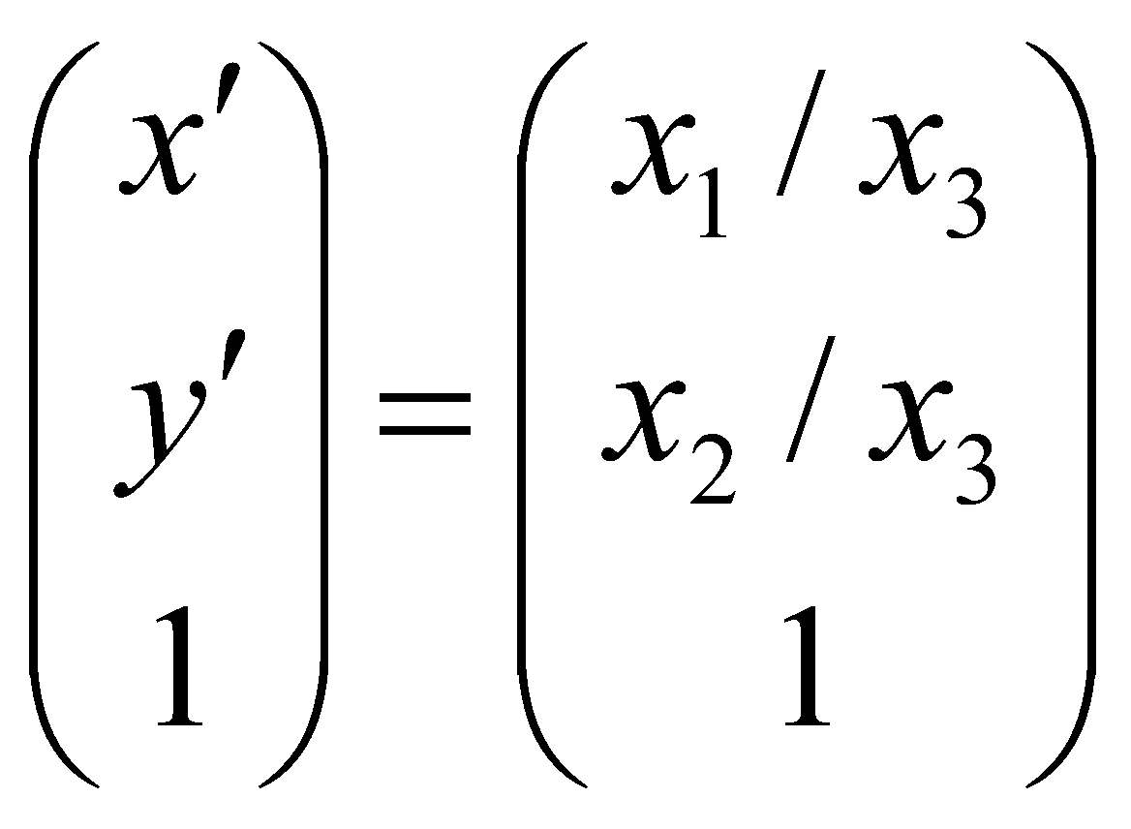
Projective Transform (Homography)
Most general type of linear 2D-2D transform
H is an arbitrary 3x3 matrix
We still need to divide by the 3rd element
As we will see later, a homography maps points from the projection of one plane to the projection of another plane
‹#›
Notes:
Does not necessarily preserve parallel lines, but straight lines remain straight.

Slide 28
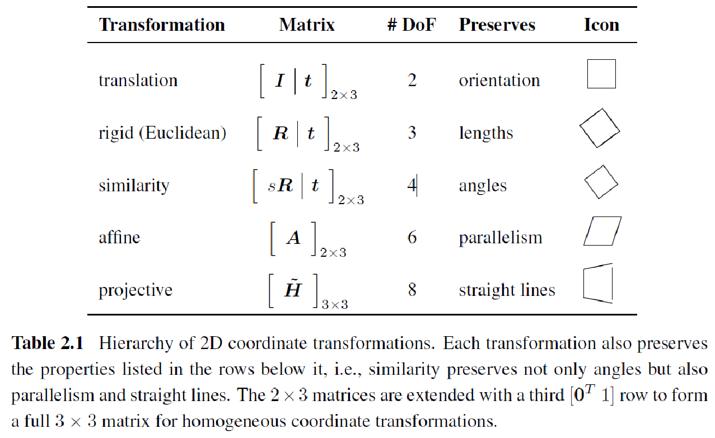
From Szeliski, Computer Vision: Algorithms and Applications
‹#›

